Slide 1
Solution Architecture DIGITAL BI PLATFORM
Mar 2022

Slide 2
Table of Contents
Program Goals, Objectives & Themes
High Level Solution Architecture
GCP Technical Architecture
Infosys Solution Accelerators
Historical Data Migration Framework
Incremental Data Load Framework

Slide 3















Program Goals and Objectives
A Data Consumption Platform that is more than a reporting environment
Data Science & Advanced Analytics Self-serve environment
Digital Data Asset Knowledge Share
Goal:
To make analytics more relevant and efficient, to accelerate time to insights, and to foster data driven decision-making, and innovation
Anomaly Detection platform to ensure data accuracy
AI/ML Data Modeling environment
AEP Data Integration for contextual marketing
Server-Side Tagging environment
Digital OKR: Empower Digital to leverage comprehensive and reliable data to magnify business reporting insights & deliver exceptional customer experience
Benefits
Digital First
Faster Time To Insights
Omnichannel Enterprise View
Expedite GTM
Data Quality/Reliability
Self-service
Innovation (Green Field)
Scale On Demand
Democratization Of Data
Compliance, Governance, & Privacy

Slide 4
THE BAKER’S DOZEN: TOP-13 RECURRING THEMES FROM STAKEHOLDERS
FOUNDATIONAL
BUSINESS EXCELLENCE
SELF-CONTAINED
1
5
10
Full Funnel Reporting
(journey level views)
Automate A/B Test Reporting
Ingest & Stitch Critical Data Silos
2
6
12
Improve Data Availability & Latency
Deactivations → Churn
Analysis → LTV Calculation
Cross-channel / Omni-channel
3
7
13
Bring in Network Data
Slice by LOBs
Targets Database - QGP, LRP
4
8
Integrate Existing TMO Data Assets
Inventory & Stock
11
9
NPS & OCX Data/Reporting/Analytics
Near-real-time & Event-driven Data

Slide 5

Target High Level Solution Architecture for Digital BI Platform (draft)
TMO Data Center
MSFTP
Server
Data Exploration
Analysis & Exploration
Data Science & ML/AI
Model Dev, Tuning, Deploy
Consumption
Reports| Dashboards
Source Systems
(TMO
Internal)
On-Premise
Connectivity (Interconnect)
Consumption
(Internal/ External)
Reports| Dashboards | File Extract | API
Data Acquisition Cluster
Data Lake (Store)
Landing Zone| Bronze | Silver | Gold (ZONES)
Data
Masking
Metadata Store
Execution Engine
Metadata Extraction | Query Generation | Transformation | Containerization
Orchestration (Scheduler | Code Repository)
Source Systems
External
Direct
Cloud-to-Cloud
Security and Governance
Catalog | Security
Monitoring
Logging | Monitoring
Legend: Digital BI

Slide 6
Data Sources
MSFTP
Server
Data Exploration
Analysis & Exploration
Data Science & ML/AI
Model Dev, Tuning, Deploy
Consumption
Reports| Dashboards
On-Premise
Source Systems
Connectivity (Interconnect)
Consumption
(Internal/ External)
Reports| Dashboards | File Extract | API
Data Acquisition Cluster
Data Lake (Store)
Landing Zone| Bronze | Silver | Gold (ZONES)
Data
Masking
Metadata Store
Execution Engine
Metadata Extraction | Query Generation | Transformation | Containerization
Orchestration (Scheduler | Code Repository)
Source Systems
External
Direct
Cloud-to-Cloud
Security and Governance
Catalog | Security
Monitoring
Logging | Monitoring
Legend: Digital BI

Slide 7

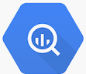









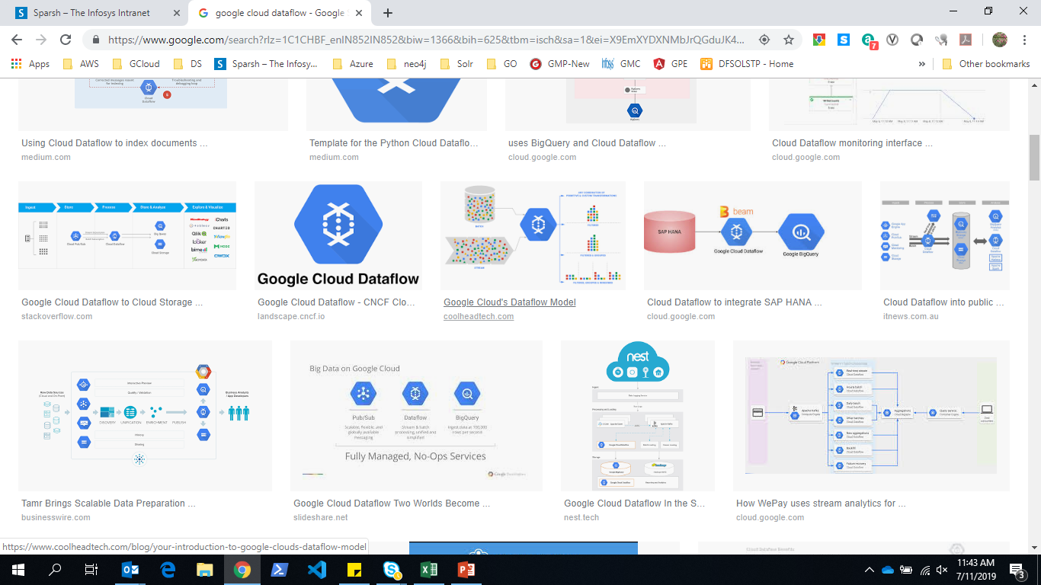





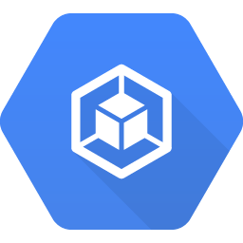



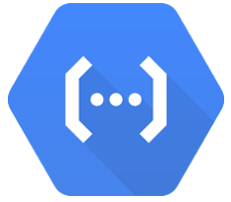






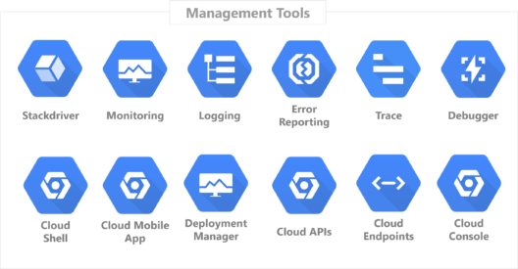


Technical Architecture with GCP Components (draft)
On-Premise
On-Premise
Source Systems
Data Exploration
Data Science & AI/ML
Consumption
I360 Networks
Azure Databricks
1
NPS-Flat Files
Batch Jobs
(Masked Data)
Batch Jobs
(No Confidential Data)
Vertex AI Workbench
External/Third party
Storage Transfer Service
BigQuery ML
Auto ML
Vertex AI
AI Platform
Dialogflow
Data Studio
Adobe Analytics-FF
Cloud SDK GSUTIL
Bastion Host/Edge Server
File Extracts
SAP Hourly Orders
ACQUISITION
Data Lake
1
ODBC
JDBC
ODATA
SFTP
.Net API
Python API
RPA
Cloud Storage
SILVER
8
GOLD
APIs
TD Daily Orders
3
4
BRONZE
6
SCOpsBI SQL Server
Batch Jobs
(Unmasked)
TUPL(network)
Cluster
BigQuery
BigQuery
(Curated
Semantic)
Store source systems data for masking
LANDING
RAW
Consumption
AEP (Segments)-FF
Kafka
BigQuery
Data Products
Semantic
CSR TD (Activations)
Real Time Jobs
Real Time Streaming
RIS–Azure SQL Server
Pub/Sub
Dataflow
File Schema Validation
Data Quality
Aggregations
De-normalizations
Transformation
NBA Data
2
Data Masking
5
Invoca (Calls)
OCX-FF
Execution Engine
Metadata Extraction
Query Generator service
Query
Conversion
& Execution
Samson
Metro
Confidential Data Masking if masking is not done at Source
4
SFDC
Sprint
Firestore Metastore DB
7
Container
Registry
Kubernetes Engine
Amperity
Cupid
eKMS Encryption Methods
Nuance
DVOC
Orchestration
Care
Retail
Surveys
TM1
Connectivity (Dedicated
Interconnect)
Compute Engine
Cloud Function
Source Code Repository
Cloud Build
Cloud Composer
Page Elements
Google Floodlight
Security and Governance
Integration with TMO Governance Platform
Monitoring
Credit Apps
KMS
Data Catalog
Cloud Logging
Cloud Monitoring
Chronicle Detect
Infosys Operations
Workbench
Cloud IAM
Social Media/Chats
Note: In the Solution architecture Step#2, un-masked source data masking approach needs further reviews to finalize the solution of the data masking

Slide 8
Architecture Solution Component and GCP Services – Immediate & Future for Dev & Pre-Prod infrastructure
Architecture Solution Component | Solution Component | GCP Infrastructure & Services | Activities performed
On-Premise Data Acquisition | Data Acquisition Cluster | Linux VM server on-premise (not GCP) | Landing server, Data masking , SFTP/MFT server
Data Lake (Store) | File Storage | Cloud Storage | Raw Zone (Landing) & Archived Layer
 | Database | BigQuery | Bronze, Silver, Gold Zone
Metadata Store | Metadata Storage | FireStore | Storing metadata for Pipeline creations & execution
Execution Engine | Real-Time streaming | Kafka, Pub/Sub, DataFlow | Processing of streaming data
 | Compute Engine | Cloud Functions, Container Registry, GKE | For pipeline creation & execution
 | Transformation Framework | DBT (data build tool) | Transformed/Aggregated data models in BQ
 | Processing Language | Python
Orchestration | Orchestration/Scheduling | Cloud Composer (GKE) | Job executions
 | CI/CD | Source Code Repository, Cloud Build, Terraform | CI/CD pipeline
Security & Governance | Security | Cloud IAM, KMS
 | Governance | Data Catalog
Monitoring | Monitoring | Cloud Logging, Cloud Monitoring, Chronicle Detect | Chronicle Detect (Threat Detection)
 | Email Notification | SendGrid by Fivetran | Alert & Email notification for job status
Consumption | Anomaly Detection | Looker | Anomaly Detection and Visualization
 | Dashboard | Data Studio | Dashboard for operations + Data Catalog reports
Data Exploration | Data Labs | Vertex AI Workbench | Data Exploration, Visualization & Analysis
Data Science (ML/AI Ops) | Model Dev, Tuning, Deployment | BigQuery ML, Vertex AI, AI Platform, DialogFlow | AI & ML
Future need, tentatively required by May’ 2022

Slide 9
Data Lake– Bronze & Silver Zones
LANDING ZONE
Google
Storage(GCS)
Parameter | BRONZE Zone | SILVER Zone
Definition | For each source data file type in GCS there will be a dedicated table available in this zone | For each table in BRONZE there will be a Curated table available in this Zone
Table Naming | “stg_” + source file name without datetime | source file name without datetime
Values | Source values | Standardized and validated
Data Quality | NO | Technical quality checks
Validations/ Transformations | Schema validation + Error records Threshold | Data Validation & basic transformation
Governance | New sources and source changes | New sources, source changes and new usage.
Load Strategy | Truncate & Load | UPSERT/ APPEND
Persistent | NO | YES
Volume (Vs Source) | As Received from Source (Full or Delta) | Full + History
SCD / Historized | NO | AS-IS from Source
Data Hierarchy | NO | AS-IS from Source
Partitioned | NO | YES
Encryption | YES | YES
Security /Data Access | ETL Layer No access to analytics users | ETL Layer, Analytics, Power Users
Compressed | BQ Compression | BQ Compression
Data Archived | NO | YES
Data Purging | YES | NO
Data Managed By | Data Platform | Data Platform
Functional Characteristics
Schema validation + Error record Threshold
BRONZE ZONE
Technical Characteristics
Technical DQ checks, Basic transformation (Casting, Attribute name change)
SILVER ZONE

Slide 10
Data Lake – Gold Zone
Parameter | GOLD Zone
Definition | Data domain & Data product driven data models with transformed and aggregated data
Table Naming | Standardized as per Industry Domains
Values | Fully Standardized and validated
Data Quality | Full detective quality
Grain Of the Data | Consumption driven
Governance | Fully Governed
Load Strategy | UPSERT/ APPEND
Persistent | YES
Volume (Vs Source) | Transformed & Aggregated
SCD / Historized | AS-IS from Source
Data Hierarchy | YES
Partitioned | YES
Encryption | YES
Security /Data Access | ETL Layer, Analytics Ad-hoc Queries, Power Users
Compressed | BQ Compression
Data Archived | YES
Data Purging | NO
Data Managed By | Data Platform
SILVER ZONE
Functional Characteristics
Data anomaly detection, Transformation and aggregations by data product
GOLD ZONE
Technical Characteristics

Slide 11
Infosys Solution Accelerators

Slide 12







GCP Data Ingestion Framework - Automated Metadata driven template-based ingestion pipeline framework for Data Platforms
Template Driven Automated Pipeline Creation
Key Differentiators
Intended Use:
About Framework?
Abstracts underlying GCP Serverless Services
Framework is tested and optimized to load high volumes of data from given flat file types.
Accelerate design & development of data pipelines
Loosely Coupled:
Fully componentized
Built on Open Source DBT for transformations
Self Service Excel/JSON template to Setup and Operationalize data pipelines
Handles:
. Schema validations
Incremental loads to Silver layer with DBT models .
Technical data quality checks on BigQuery Bronze Layer
Gold layer DBT model having transform logic written by developers
Workflow generator for Cloud Composer
Real Time Streaming
Cloud Storage Landing to Raw to BigQuery Bronze load
Extract incremental data directly from Source Systems to flat files and transfer to GCS Landing Layer
BigQuery Bronze to BigQuery Silver layer loads
BigQuery Silver to BigQuery Gold layer loads
BigQuery Bronze. Silver & Gold layer tables creation
Future Plan :
CI/CD
Alert Notifications, Audit & Logging
Self Service UI
Data Engineering Productivity Improvement through Extreme Automation with event driven pipelines.
Using cloud native technologies for server less execution
Event based Data pipelines with complete abstraction of Technology
Template Driven
Self-Service UI
Cloud Native
Design
Infosys GCP Data Ingestion Framework
Auto Generation of Data pipelines with Extreme Automation
Automated Pipeline
Unified Metadata
Enable Metadata driven Ingestion Framework from variety of sources
Transformations with DBT
Seamless Integration
CI/CD
Ability to perform Schema, Syntax, Data and Semantic Validation
Seamless integration with GCP Serverless Services
Seamless Integration with Continuous Integration and Deployment
Event Driven Workflow Generator
Execution
On-Premise
GCP
/
GCS Landing
Cloud Function
Composer DAGs
BigQuery with DBT Pipeline
Any Other Cloud
Framework evolution
Future needs
12

Slide 13
Functional Catalogue
This framework provides the below functionality and details of the functionality's development in progress/to be started/to be planned and future plan
Source
Connectivity
Target
File Formats
DDL & DMLs Creation
Mode of Extraction and Load
Data Processing
Security
Operations
RDBMS – Teradata/Oracle/SQL Server
GCP Cloud Storage
Delimited Files Fixed Width files
Bronze Layer - BigQuery Stage Table Creation
Truncate & Load
Bronze Layer Technical DQ Checks
RBAC/Service Accounts
Audit and Execution History – Firestore DB
Flat Files
GCP BigQuery
PARQUET / AVRO/ ORC
Silver Layer – BigQuery Target Table Creation
Incremental Load
Incremental Load Services – Merge
Cloud Native IAM/KMS
Scheduler – Cloud Composer
Azure
Cloud SQL – SQL Server
Firestore DB For Metadata Storage
Silver Layer - BigQuery DBT Model Creation
Append
BigQuery DBT Model Auto Publishing
Audit and Execution History – BigQuery DB
Azure Data Bricks Delta Lake
Real Time Data, Time Series Data etc. (GCP BigTable)
Gold Layer - BigQuery Target Table Creation
Historical Load
Silver Layer – Technical DQ Checks – History Load
CI/CD
Other Sources
(If Any)
Real Time Streaming
Alert Notification
Available
Dashboard to Show Execution & Audit Details
In Progress / Dependency on Infra
Future needs
13

Slide 14
Historical Data Migration Framework
Infosys Solution Accelerators

Slide 15
Historical Data Loading Framework – Types of Source Tables
1. Non-partitioned Tables Historical Data Load & Data Sync-up:
Non-Partitioned Tables
Ex: Reference/ Master/ Dimension Tables
Extract full table data with masking of Confidential Data to flat file
Compress & Transfer to GCS Landing Bucket
Historical Data Load Framework Get Involved
Truncate & Load to BigQuery Silver Layer Table – BQ Batch Load
2. Partitioned Tables Historical Data Load - Full Partition Data Publish From Source/New & Changed Data Publish From Source:
Partitioned Tables
Ex: Transactional/Fact Tables
Extract partition wise data from the table with masking of Confidential Data to flat file
Compress & Transfer to GCS Landing Bucket
Historical Data Load Framework Get Involved
Remove Partition If Exists & Load to BigQuery Silver Layer Table – BQ Batch Load
3. Partitioned Tables Data Sync-Up - Full Partition Data Publish From Source System: Use the above approach 2
4. Partitioned Tables Data Sync-Up - New & Changed Data Only Published from Source Systems: Use the Ingestion Framework Incremental Load

Slide 16
Historical Data Loading Framework - GCP Cloud Storage, BigQuery & DAGs
1. Framework Metadata Upload - Google Cloud Storage
4. Loading Data & Audit Files - Google Cloud Storage
ingfrm-histload-metadata-landing
dmsd-histload-data-landing
<src>
<src>
inbound
Filled template is placed here
ingfrm-histload-metadata-raw
inbound
Source Data Files Upload path
dmsd-histload-audit-landing
outbound
Output Data Files Upload Path
<src>
<src>
common
Ingestion framework files are available here
inbound
Source Audit Files Upload path
ingfrm-histload-metadata-archive
inbound
JSON Files to process and create the pipeline code
outbound
Output Audit Files Upload Path
dmsd-histload-raw
<src>
outbound
Framework Generated Code Files
<src>
inbound
Processing Data & Audit Files path
dmsd-histload-archive
outbound
Outbound Data & Audit Files Path
inbound
Moves files to achieve/ error/quarantine buckets after processing completion based on the execution status and these buckets will have object Lifecycle Policies to move files to Nearline/Coldline/Archive Storage
<src>
ingfrm-histload-metadata-error
outbound
inbound
Moves files to achieve/ error/quarantine buckets after processing completion based on the execution status and these buckets will have object Lifecycle Policies to move files to Nearline/Coldline/Archive Storage
<src>
dmsd-histload-error
outbound
inbound
<src>
outbound
Inbound
2. Framework Created Data Pipeline - DAG
outbound
initialization
landing_to_raw
raw_to_bq_silver_load
audit_validations_load
5. Data Pipeline After Execution (DAG)
[DAG]
3.Framework Created BigQuery Tables
initialization
<src>
bronze
dms_demo_bronze.stg_sales
master
landing_to_raw
silver
dms_demo_silver.sales
dms_master.<tablename>
raw_to_bq_silver_load
gold
dms_demo_gold.<tablename>
audit_validations_load
ref
dms_demo_ref.<tablename>
16

Slide 17


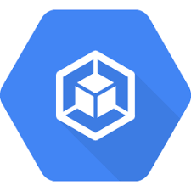


Historical Data Loading Framework – Code Generation Solution Architecture
Firestore DB Load
Conversion Excel to JSON &
Upload Into NoSQL DB
Upload of Excel/JSON Metadata File By
A Developer or
An Automated Transfer from Source System to Cluster Machine
Historical Data load Framework Metadata Landing Bucket
Triggers Historical Load Framework to Generate Pipeline Code for given Metadata File
Firestore
GCS API/
SFTP/
GSUTIL/
Manual
Transfer
Data Formatting
Date Formats
Timestamp Formats
Google Cloud Function
Cluster
Developers
Google Cloud Storage
BigQuery Tables Creation
Silver Table DDL Creation
Deploy DDLs into BigQuery DB
Archival Bucket
Store Metadata Files & Generated Code Files
BigQuery
Google Cloud Storage
Composer Cloud Storage – DAG Creation
Create DAG with Pipeline Tasks
Deploy in dags Folder of Composer Cloud Storage Bucket
Composer Cloud Storage
Cloud Composer
17

Slide 18
Historical Data Loading Framework –Data Loading Solution Architectrue
Upload of Data & Audit File By
Developers/Users
Triggers Cloud Function
Request for DAG Name
Historical Data File Raw Bucket & Audit File Landing Bucket
E2
E3
Check DAG Name of given audit file name
An Automated Data & Audit File Transfer from Source System to Cluster Machine
E1
Cloud Firestore
| Metastore DB
Cluster
Cloud Functions |
Calling DAG
Cloud Storage
Sends DAG Name of given audit file name
E4
Response of DAG Name
SFTP Data & Audit File Directly from Source System
GSUTIL/SFTP/ Storage Transfer Service/
Manual Transfer
E5
Log Auditing details
Storage Transfer Service –Data & Audit Files Transfer from Other Cloud Storage to GCP Cloud Storage Landing Buckets
Cloud Firestore
| Metastore DB
E10
Composer DAG
Semantic Engineering Model
E6
E7
E8
E9
Cloud Storage-Landing
Cloud Storage-Raw
BigQuery
Silver Layer
BigQuery
Audit Table
Error
Bucket
Initialize
Achieve
Bucket
Landing To Raw
Raw To Silver Layer
Audit Validations Load
Initialize operator executes reliability check. If any issues with input data is moved to error bucket
Landing To Raw operator validates schema, check audit file metrics with data file and moves the valid file to raw Bucket. If any error, then moves data file to error bucket and logs the load failure error
Raw to Silver Operator loads data file from the raw bucket to the BigQuery table using the BQ load
Audit Validations Load Operator reads the given data file, audit file and fetches the corresponding metrics from the Silver BQ Table load of current run, loads the validation details into the BigQuery audit table. Completes the task successfully if data, audit file and silver table metrics are matching else logs the load failure
18

Slide 19
Incremental Data Load Framework
Infosys Solution Accelerators

Slide 20
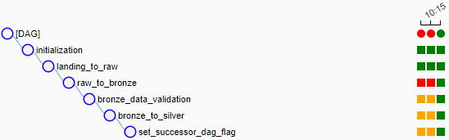
GCP Cloud Storage, BigQuery & DAGs
1. Framework Metadata Upload - Google Cloud Storage
4. Loading Data Files - Google Cloud Storage
ingfrm-metadata-landing
digitalms-landing
<src>
<src>
inbound
Filled template is placed here
ingfrm-metadata-raw
inbound
Source Data Files Upload path
<src>
digitalms-raw
outbound
Output Data Files Upload Path
common
Ingestion framework files are available here
<src>
JSON Files to process and create the pipeline code
inbound
Processing Data Files path
ingfrm-metadata-archive
inbound
digitalms-quarantine
outbound
Outbound Data Files Path
outbound
Framework Generated Code Files
<src>
<src>
Moves files to achieve/ error/quarantine buckets after processing completion based on the execution status and these buckets will have object Lifecycle Policies to move files to Nearline/Coldline/Archive Storage
inbound
Source Data Files Under Error Threshold Limit path
ingfrm-metadata-error
inbound
Outbound Error Data Files Path
digitalms-archive
outbound
outbound
<src>
Moves files to achieve/ error/quarantine buckets after processing completion based on the execution status and these buckets will have object Lifecycle Policies to move files to Nearline/Coldline/Archive Storage
<src>
inbound
inbound
digitalms-error
outbound
outbound
<src>
2. Framework Created Data Pipeline - DAG
Inbound
outbound
5. Data Pipeline After Execution (DAG)
3.Framework Created BigQuery Tables
<src>
bronze
digitalms_demo_bronze.stg_sales
master
silver
digitalms_demo_silver.sales
digitalms_master.<tablename>
gold
digitalms_demo_gold.<tablename>
20

Slide 21

Code Generation By Ingestion Framework – Upload Metadata Excel File
Firestore DB Load
Conversion Excel to JSON &
Upload Into NoSQL DB
Firestore
BigQuery Tables Creation
Bronze Table DDL Creation
Silver Table DDL Creation
Deploy DDLs into BigQuery DB
BigQuery
Upload of Excel/JSON Metadata File By
A Developer or
An Automated Transfer from Source System to Cluster Machine
Ingestion Framework Metadata Landing Bucket
Triggers Ingestion Framework to Generate Pipeline Code for given Metadata File
Container Registry BQ DBT Models
Create for Bronze Table DQ Checks
Create for Silver Table Loading
Create New Image & Upload
GCS API/
SFTP/
GSUTIL/
Manual
Transfer
Container Registry
Google Cloud Function
Cloud Composer Env. Variable URL Update
Fetch the Latest Docker Image URL from Container Registry
Update Environment Variable
Cluster
Developers
Google Cloud Storage
Cloud
Composer
Archival Bucket
Store Metadata Files & Generated Code Files
Composer Cloud Storage – DAG Creation
Create DAG with Pipeline Tasks
Deploy in dags Folder of Composer Cloud Storage Bucket
Composer Cloud Storage
Google Cloud Storage
21

Slide 22


Pipelines Execution & Data Loading By Uploading Source Data Files
Upload of Data File By
Developers/Users
E1
Data Files Landing Bucket
E2
Triggers Cloud Function
E3
Request for DAG Name
E4
Check DAG Name of given data file name
An Automated Data File Transfer from Source System to Cluster Machine
Cloud Run |
Custom API
Cloud Firestore
| Metastore DB
Cloud Functions |
Calling DAG
Cluster
Cloud Storage
Response of DAG Name
Sends DAG Name of given data file name
E6
E5
SFTP Data File Directly from Source System
GCS API/SFTP/
GSUTIL/Manual
Transfer
E7
Composer DAG
Semantic Engineering Model
E8
E9
E10
E11
E12
E13
Cloud Storage
Cloud Storage
Docker
GKE
BigQuery
BigQuery
BigQuery
BigQuery
Silver To Gold
(Semantic Layer)
Cloud Run
Landing To Raw
Raw To Bronze
(Staging Layer)
Bronze Data Quality Checks
Bronze To Silver
(Curated Layer)
Initialize
Container Registry
Error Bucket
Achieve Bucket
Initialize operator executes reliability check. If any issues with input data is moved to quarantine bucket
Landing To Raw operator validates schema and moves the valid data to raw Bucket. If any error, then check for threshold if the threshold is met then the entire input data to quarantine bucket else just the error rows are moves to quarantine
Syntax Validated Input data is seeded into BigQuery Bronze layer
Unified Semantic Data process then Bronze layer table technical data quality checks process and fails the load if checks are failed else continues DAGs next task execution
Unified Semantic Data process then calls the Data Curation process then load incremental data from bronze table to silver table
Unified Semantic Data process then calls the unified part to enrich data with any metrics and blending silver data to Gold Layer tables
22

Slide 23
Thank You

Slide 24
Historical Data Loading Framework – Auditing & Validations (1/2)
Below validations are performed and its status details are logged into the BigQuery Audit Log Table.
Checksum of the source data file in the on-premise from Audit file and checksum of actual data file in the Cloud storage
Record Counts of the source data file from the Audit File, actual data file in the Cloud Storage & Silver table of current run
Key metric columns values of the Audit file and corresponding columns values BigQuery Silver table of current run
DAG tasks run details are stored in the Firestore Metastore for each file load and the same is migrated to BigQuery Job Run Log Table for analysis and dashboards/reports creation.
Historical Data Load – Load Success Status of Current Run into Firestore DB
Historical Data Load – Audit File of Current Run
Historical Data Load – Load all metrics into BigQuery Audit Log Table & Log Success Status of Current Run
Audit File, Data File, BQ Load Metrics of current load are Matched?
Historical Data Load – Data File of Current Run
Yes
Fetch Audit File metrics, Derive the Data file metrics and derive the Silver BQ Load table metrics of current run based on the audit file and join all
Historical Data Load – Load all metrics into BigQuery Audit Log Table & Log Failure Status of Current Run
Historical Data Load – BigQuery Silver Table of Current Run
No
Historical Data Load – Load Failed Status of Current Run into Firestore DB

Slide 25
Historical Data Loading Framework – Auditing & Data Validations (2/2)
AUDIT FILE SAMPLE FORMAT
DataFileName,MetricName,PartitionName,MetricColumnName,MetricValue
demo_sales_02222022.csv,COUNT,2022-02-22,ORDER_DATE,100
demo_sales_02222022.csv,CHECKSUM,2022-02-22,,7d2186aaeed78b24f00f782f2346e5f9
demo_sales_02222022.csv,SUM, 2022-02-22,ORDER_VALUE,2000
demo_sales_02222022.csv,MAXLENGTH, 2022-02-22,ORDER_DESC,244
Metric Name Possible values:
COUNT, SUM,MAX,MIN,AVG on numeric columns
CHECKSUM for data file size check
MAXLENGTH for string column max length checks
BIGQUERY AUDIT LOG
DATA_FILE_NAME | DATASET_ NAME | TABLE_ NAME | LOAD_ DATETIME | PARTITION_NAME | METRIC_ NAME | METRIC_ COL_NAME | AUDIT_ FILE_VAL | BQ_TABLE_ VAL | DATA_FILE_ VAL | MATCHED
demo_sales_02222022.csv | dms_demo_silver | sales | 2022-02-23 11:11:11 | 2022-02-22 | COUNT | ORDER_DATE | 100 | 100 | 100 | Y
demo_sales_02222022.csv | dms_demo_silver | sales | 2022-02-23 11:11:11 | 2022-02-22 | CHECKSUM (MD5HASH) |  | 7d2186aaeed78b24f00f782f2346e5f9 |  | 7d2186aaeed78b24f00f782f2346e5f9 | Y
demo_sales_02222022.csv | dms_demo_silver | sales | 2022-02-23 11:11:11 | 2022-02-22 | SUM | ORDER_VALUE | 2000 | 2000 |  | Y
demo_sales_02222022.csv | dms_demo_silver | sales | 2022-02-23 11:11:11 | 2022-02-22 | MAXLENGTH | ORDER_DESC | 244 | 244 |  | Y
demo_sales_02222022.csv | dms_demo_silver | sales | 2022-02-23 11:11:11 | 2022-02-22 | UNIQUE CHECK | ORDER_ID |  | 100 | 100 | Y

Slide 26
Target Solution Architecture for Digital BI Platform on Google Cloud Platform (GCP) (draft)
TMO Data Center
MSFTP
Server
Data Exploration
Vertex AI Workbench
Data Science & ML/AI
Model Dev, Tuning, Deploy
Consume
(Internal/ External)
Reports| Dashboards | File Extract | API
Source Systems
(TMO
Internal)
Connectivity (Interconnect/
S2S VPN)
Edge Server (Bastion Host)
Data Lake (Store)
Landing Zone| Bronze | Silver | Gold (ZONES)
Data Acquisition Cluster
Data
Masking
Metadata Store
Execution Engine
Metadata Extraction | Query Generation | Transformation | Containerization
Orchestration (Scheduler | Code Repository)
Source Systems
External
Direct
Cloud-to-Cloud
Security and Governance
Catalog | Security
Monitoring
Logging | Monitoring
Legend: Digital BI Component

